Slide 1
Road Accident analysis
by Swapnil Paraskar

Slide 2
Problem statement
Chart’s Requirement
Client wants to create a Road Accident Dashboard for year 2021 and 2022 so that they can have insight on the below requirements-
Primary KPI - Total Casualties and Total Accident values for Current Year and YoY growth.
Primary KPI’s - Total Casualties by Accident Severity for Current Year and YoY growth.
Secondary KPI’S – Total Casualties with respect to vehicle type for Current year.
Monthly trend showing comparison of casualties for Current year and Previous year.
Casualties by Road Type for Current year.
Current Year Casualties by Area/Location & by Day/Night.
Total Casualties and Total Accidents by Location

Slide 3
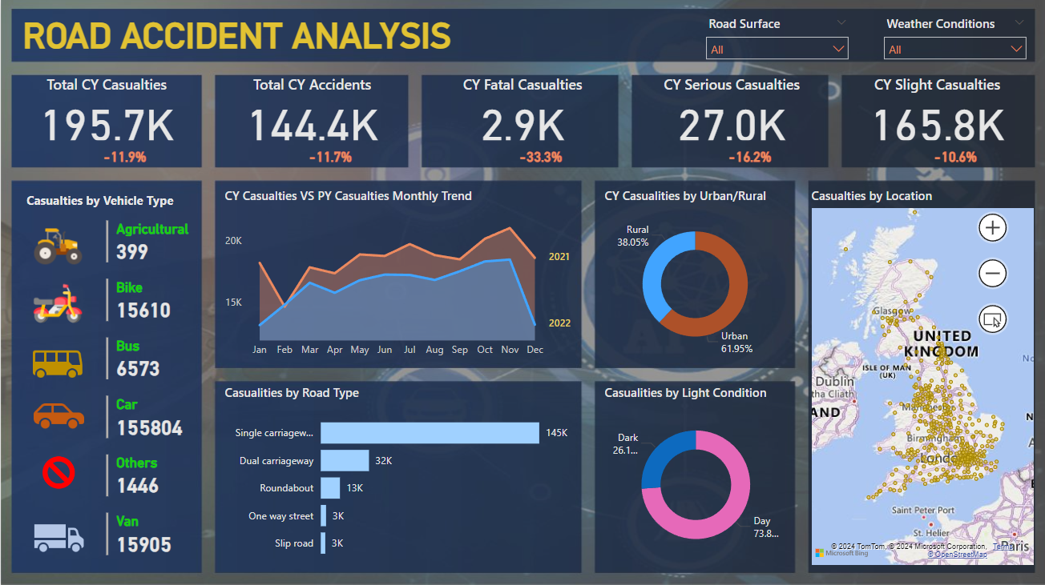
Power BI

Slide 4
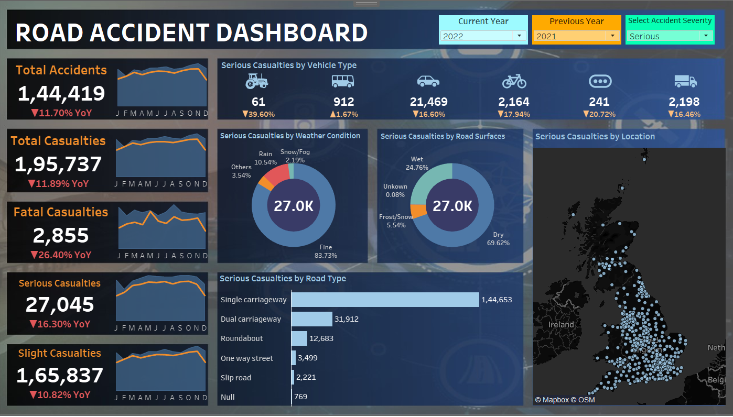
TABLEAU

Slide 5
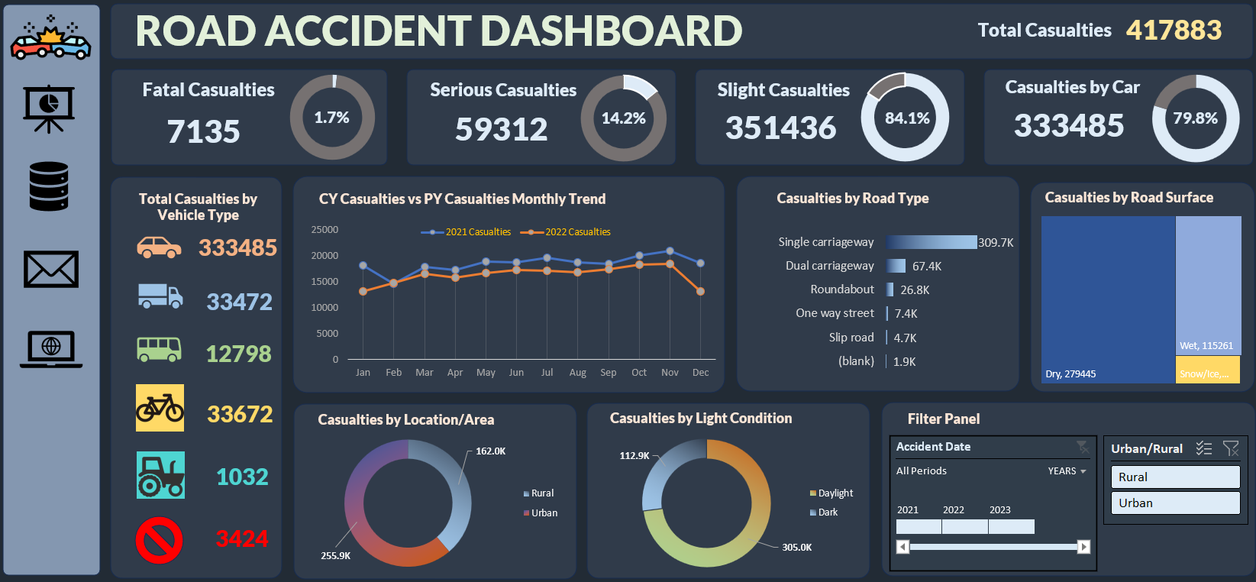
MS Excel

Slide 6
Thank you
Swapnil Paraskar
swapnilparaskar78@gmail.com

